Slide 1
What is an API Gateway?
Networking & Communication

Slide 2
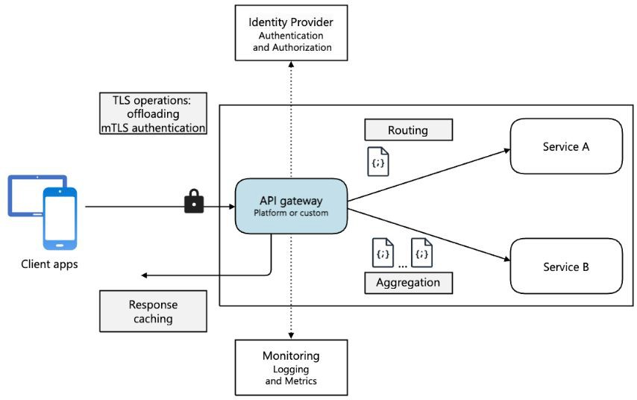
Introduction to API Gateways
In modern system architecture, APIs connect clients (web, mobile,
third-party apps) to backend services.
Directly exposing backend services can lead to performance, security, and management challenges.
API Gateway is a centralized entry point for all API requests, handling authentication, routing, caching, and security.

Slide 3
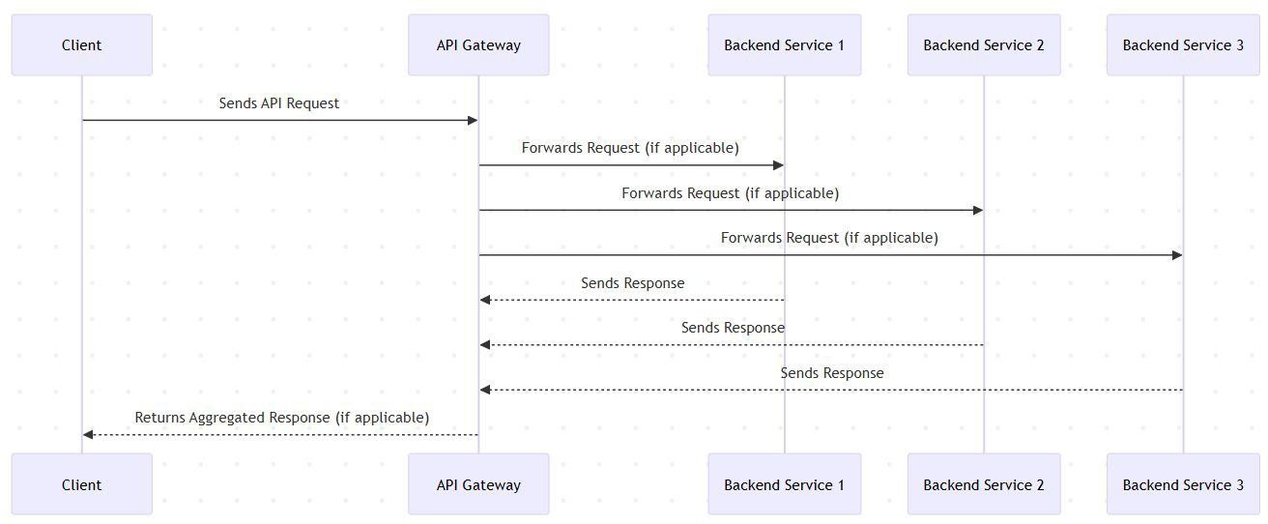
How API Gateways Work?
API Gateway acts as a reverse proxy between clients and backend services.
It receives API requests, processes them, and forwards them to the correct service.
Key functions include request transformation, authentication, rate limiting, and response handling.

Slide 4
Beneﬁts of Using an API Gateway
Security: Protects backend services from direct exposure.
Rate Limiting: Prevents abuse &
DDoS attacks.
Load Balancing: Distributes traﬃc eﬃciently.
Caching: Speeds up response times.
Request Transformation: Converts request formats, protocols, and headers.
Logging & Monitoring: Tracks API
performance and security events.

Slide 5
Security Features in API Gateways
Authentication & Authorization: Supports OAuth, JWT, API keys.
DDoS Protection: Blocks excessive requests from malicious sources.
Bot Protection: Uses rate limiting & CAPTCHA to ﬁlter out bot traﬃc.
TLS Termination: Handles SSL encryption to secure communication.

Slide 6
Rate Limiting & Throttling
Rate Limiting: Restricts the number of API calls per user/IP per second/minute.
Throttling: Controls traﬃc during peak loads to avoid system crashes.
Helps prevent abuse, protects backend services, and ensures fair usage.

Slide 7
Caching for Performance Optimization
Why Caching?: Speeds up API responses by storing frequently accessed data.
Types of Caching:
  In-memory caching (e.g., Redis)
  Response caching (storing API responses for quick reuse)
  Edge caching (CDN integration for global performance boost)

Slide 8
API Composition & Aggregation
API Gateways can combine multiple API calls into a single request.
Useful for microservices architecture where one client request may need data from multiple services.
Example:
  Instead of calling /user, /orders, and /cart separately,
  API Gateway calls all 3 services internally and returns a single response.

Slide 9
Logging & Monitoring with API Gateways
Helps track API performance, errors, and security threats.
Logs can be used for debugging, auditing, and analytics.
Supports integrations with tools like Prometheus, Grafana, and ELK Stack.

Slide 10
Popular API Gateway Implementations
Open-source solutions:
  Kong
  NGINX
  Traeﬁk
Cloud-based solutions:
  AWS API Gateway
  Google Apigee
  Azure API Management

Slide 11
When to Use an API Gateway?
Best suited for:
  Microservices architectures.
  Multi-client APIs (Web, Mobile, IoT).
  APIs requiring security, rate limiting, and monitoring.
Avoid if:
  Simple monolithic apps with minimal API exposure.
  Low-traﬃc, internal-only services.

Slide 12
API Gateway - Interview Questions
Basic Questions:
  What is an API Gateway, and why is it used?
  How does an API Gateway diﬀer from a Load Balancer?
  What are the key beneﬁts of using an API Gateway?
Technical Questions:
  How does an API Gateway handle authentication and authorization?
  Explain rate limiting and throttling in API Gateways.
  What caching strategies can be implemented in an API Gateway?
  How does an API Gateway improve security against DDoS attacks?
Scenario-Based Questions:
  When should you use an API Gateway in a microservices architecture?
  How would you design an API Gateway for a large-scale system with millions of users?
  What challenges might arise when implementing an API Gateway, and how would you address them?

Slide 13
Conclusion & Key Takeaways
API Gateway is a centralized entry point for managing API traﬃc.
Provides security, rate limiting, caching, and logging.
Useful for microservices & high-traﬃc applications.
Choosing the right API Gateway depends on use case & scale.
Whats next:
  Content Delivery Networks

